Slide 1
Functional Dependencies and Normalization for Relational Databases

Slide 2
Informal Design Guidelines for Relational Databases
Relational database design: The grouping of attributes to form "good" relation schemas
Two levels of relation schemas:
  The logical "user view" level
  The storage "base relation" level
Design is concerned mainly with base relations
Criteria for "good" base relations:
  Discuss informal guidelines for good relational design
  Discuss formal concepts of functional dependencies and normal forms 1NF 2NF 3NF BCNF

Slide 3
Semantics of the Relation Attributes
Each tuple in a relation should represent one entity or relationship instance
  Only foreign keys should be used to refer to other entities
  Entity and relationship attributes should be kept apart as much as possible
  Design a schema that can be explained easily relation by relation. The semantics of attributes should be easy to interpret.

Slide 4
Definition
This is the process which allows you to winnow out redundant data within your database.
This involves restructuring the tables to successively meeting higher forms of Normalization.
A properly normalized database should have the following characteristics
  Scalar values in each fields
  Absence of redundancy.
  Minimal use of null values.
  Minimal loss of information.

Slide 5
Levels of Normalization
Levels of normalization based on the amount of redundancy in the database.
Various levels of normalization are:
  First Normal Form (1NF)
  Second Normal Form (2NF)
  Third Normal Form (3NF)
  Boyce-Codd Normal Form (BCNF)
  Fourth Normal Form (4NF)
  Fifth Normal Form (5NF)
  Domain Key Normal Form (DKNF)
Redundancy
Number of Tables
Complexity
Most databases should be 3NF or BCNF in order to avoid the database anomalies.

Slide 6
Levels of Normalization
1NF
2NF
3NF
4NF
5NF
DKNF
Each higher level is a subset of the lower level

Slide 7
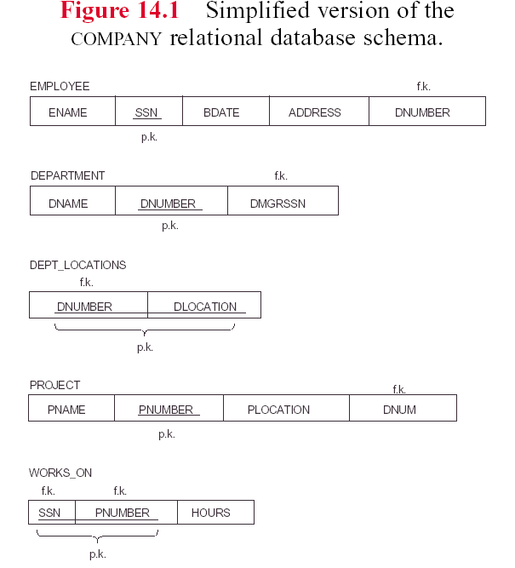

Slide 8
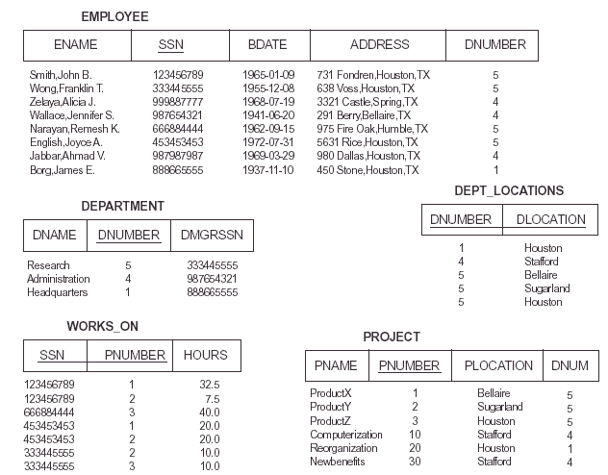

Slide 9
Redundant Information in Tuples and Update Anomalies
Mixing attributes of multiple entities may cause problems
  Information is stored redundantly wasting storage
  Problems with update anomalies:
    Insertion anomalies
    Deletion anomalies
    Modification anomalies

Slide 10
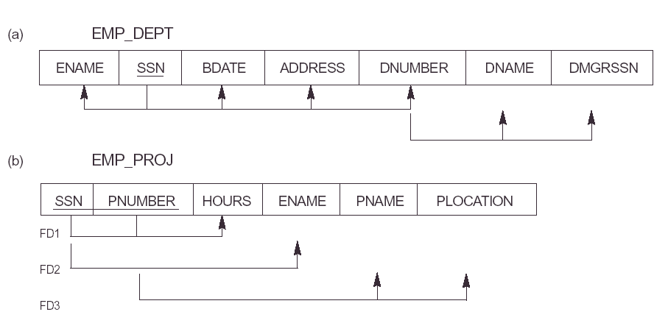

Slide 11
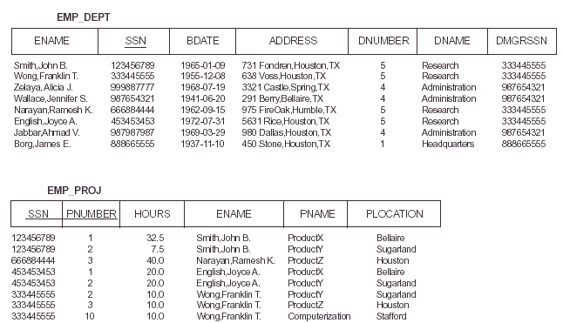

Slide 12
EXAMPLE OF AN UPDATE ANOMALY
Consider the relation:
EMP_PROJ ( Emp#, Proj#, Ename, Pname, No_hours)
  Update Anomaly
    Changing the name of project number P1 from “Billing” to “Customer-Accounting” may cause this update to be made for all 100 employees working on project P1
  Insert Anomaly
    Cannot insert a project unless an employee is assigned to .
    Inversely- Cannot insert an employee unless he/she is assigned to a project.

Slide 13
EXAMPLE OF AN UPDATE ANOMALY (2)
  Delete Anomaly
    When a project is deleted, it will result in deleting all the employees who work on that project. Alternately, if an employee is the sole employee on a project, deleting that employee would result in deleting the corresponding project.
Design a schema that does not suffer from the insertion, deletion and update anomalies. If there are any present, then note them so that applications can be made to take them into account

Slide 14
Null Values in Tuples
Relations should be designed such that their tuples will have as few NULL values as possible
  Attributes that are NULL frequently could be placed in separate relations (with the primary key)
  Reasons for nulls:
  a. attribute not applicable or invalid
  b. attribute value unkown (may exist)
  c. value known to exist, but unavailable

Slide 15
Spurious Tuples
Bad designs for a relational database may result in erroneous results for certain JOIN operations
The "lossless join" property is used to guarantee meaningful results for join operations
The relations should be designed to satisfy the lossless join condition. No spurious tuples should be generated by doing a natural-join of any relations

Slide 16
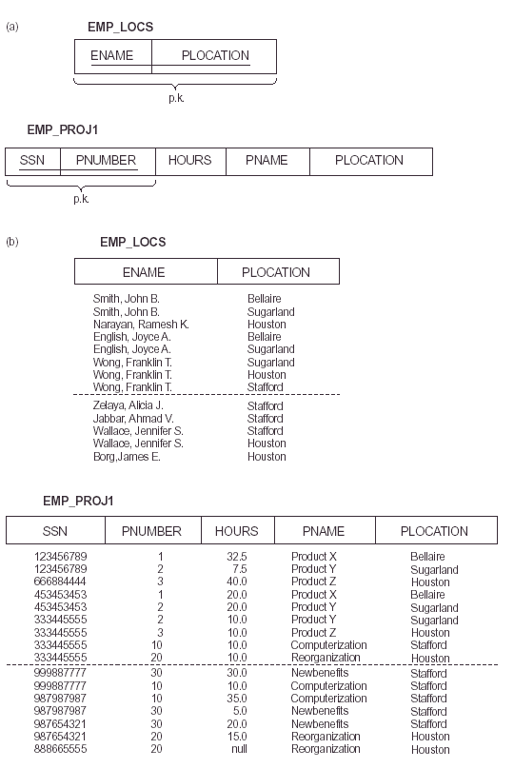

Slide 17
Functional Dependencies
Functional dependencies (FDs) are used to specify formal measures of the "goodness" of relational designs
FDs and keys are used to define normal forms for relations
FDs are constraints that are derived from the meaning and interrelationships of the data attributes

Slide 18
Functional Dependencies (2)
A set of attributes X functionally determines a set of attributes Y if the value of X determines a unique value for Y
X →Y holds if whenever two tuples have the same value for X, they must have the same value for Y
  If t1[X]=t2[X], then t1[Y]=t2[Y] in any relation instance r(R)
X → Y in R specifies a constraint on all relation instances r(R)
FDs are derived from the real-world constraints on the attributes

Slide 19
Examples of FD constraints
Social Security Number determines employee name
  SSN → ENAME
Project Number determines project name and location
  PNUMBER → {PNAME, PLOCATION}
Employee SSN and project number determines the hours per week that the employee works on the project
  {SSN, PNUMBER} → HOURS

Slide 20
Functional Dependencies (3)
An FD is a property of the attributes in the schema R
The constraint must hold on every relation instance r(R)
If K is a key of R, then K functionally determines all attributes in R (since we never have two distinct tuples with t1[K]=t2[K])

Slide 21
Inference Rules for FDs
Given a set of FDs F, we can infer additional FDs that hold whenever the FDs in F hold
Armstrong's inference rules
  A1. (Reflexive) If Y subset-of X, then X → Y
  A2. (Augmentation) If X → Y, then XZ → YZ
  (Notation: XZ stands for X U Z)
  A3. (Transitive) If X → Y and Y → Z, then X → Z
A1, A2, A3 form a sound and complete set of inference rules

Slide 22
Additional Useful Inference Rules
Decomposition
  If X → YZ, then X → Y and X → Z
Union
  If X → Y and X → Z, then X → YZ
Psuedotransitivity
  If X → Y and WY → Z, then WX → Z
Closure of a set F of FDs is the set F+ of all FDs that can be inferred from F

Slide 23
Introduction to Normalization
Normalization: Process of decomposing unsatisfactory "bad" relations by breaking up their attributes into smaller relations
Normal form: Condition using keys and FDs of a relation to certify whether a relation schema is in a particular normal form
  2NF, 3NF, BCNF based on keys and FDs of a relation schema
  4NF based on keys, multi-valued dependencies

Slide 24
First Normal Form
Disallows composite attributes, multivalued attributes, and nested relations; attributes whose values for an individual tuple are non-atomic
Considered to be part of the definition of relation

Slide 25
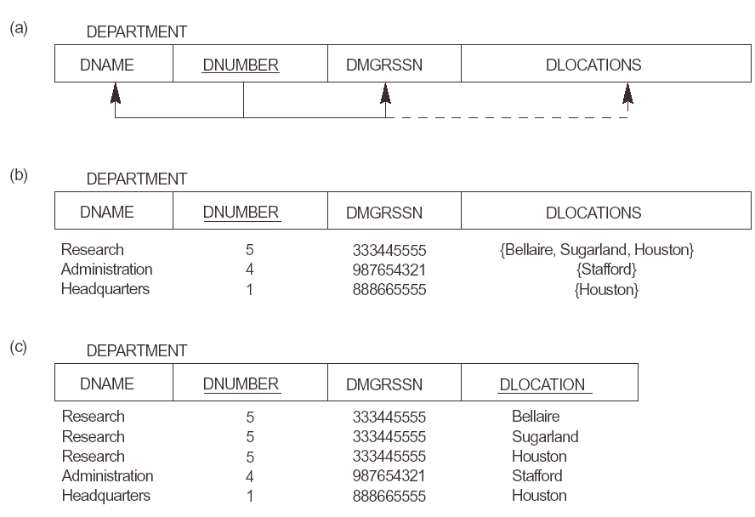

Slide 26
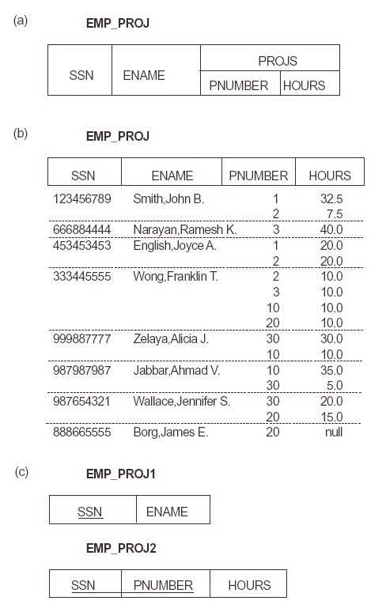

Slide 27
Second Normal Form
Uses the concepts of FDs, primary key
Definitions:
  Prime attribute - attribute that is member of the primary key K
  Full functional dependency - a FD Y → Z where removal of any attribute from Y means the FD does not hold any more

Slide 28
Examples
Second Normal Form
{SSN, PNUMBER} → HOURS is a full FD since neither SSN → HOURS nor PNUMBER → HOURS hold
{SSN, PNUMBER} → ENAME is not a full FD (it is called a partial dependency ) since SSN → ENAME also holds
A relation schema R is in second normal form (2NF) if every non-prime attribute A in R is fully functionally dependent on the primary key
R can be decomposed into 2NF relations via the process of 2NF normalization

Slide 29
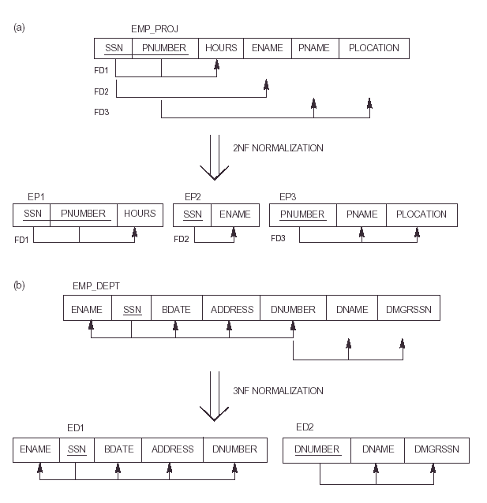

Slide 30
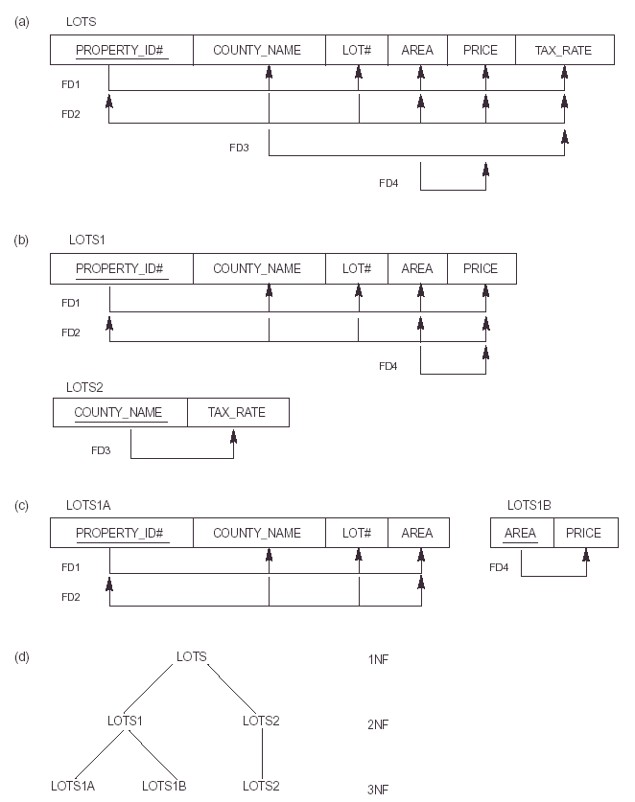

Slide 31
Third Normal Form
Definition
  Transitive functional dependency – if there a set of atribute Z that are neither a primary or candidate key and both X → Z and Y → Z holds.
Examples:
  SSN → DMGRSSN is a transitive FD since
  SSN → DNUMBER and DNUMBER → DMGRSSN hold
  SSN → ENAME is non-transitive since there is no set of
  attributes X where SSN → X and X → ENAME

Slide 32
3rd Normal Form
A relation schema R is in third normal form (3NF) if it is in 2NF and no non-prime attribute A in R is transitively dependent on the primary key

Slide 33
BCNF (Boyce-Codd Normal Form)
A relation schema R is in Boyce-Codd Normal Form (BCNF) if whenever an FD X → A holds in R, then X is a superkey of R
  Each normal form is strictly stronger than the previous one:
    Every 2NF relation is in 1NF
    Every 3NF relation is in 2NF
    Every BCNF relation is in 3NF
  There exist relations that are in 3NF but not in BCNF
  The goal is to have each relation in BCNF (or 3NF)

Slide 34
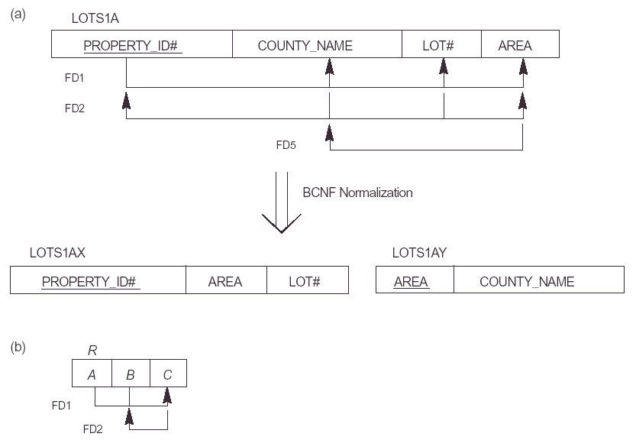

Slide 35


Slide 36
BCNF
{Student,course} → Instructor
Instructor → Course
Decomposing into 2 schemas
  {Student,Instructor} {Student,Course}
  {Course,Instructor} {Student,Course}
  {Course,Instructor} {Instructor,Student}

Slide 37
Example
Given the relation
Book(Book_title, Authorname, Book_type, Listprice, Author_affil, Publisher)
The FDs are
Book_title → Publisher, Book_type
Book_type → Listprice
Authorname →Author_affil

Slide 38
Example
What normal form the relation in?

